Slide 1
Presentation
Group 15
Shuangge Li
Tiansheng Zhang
Chengjia Feng

Slide 2
Project Topic
Financial Product Trading Platform
Product Subscription
Product Redemption
Daily Earnings Calculation

Slide 3
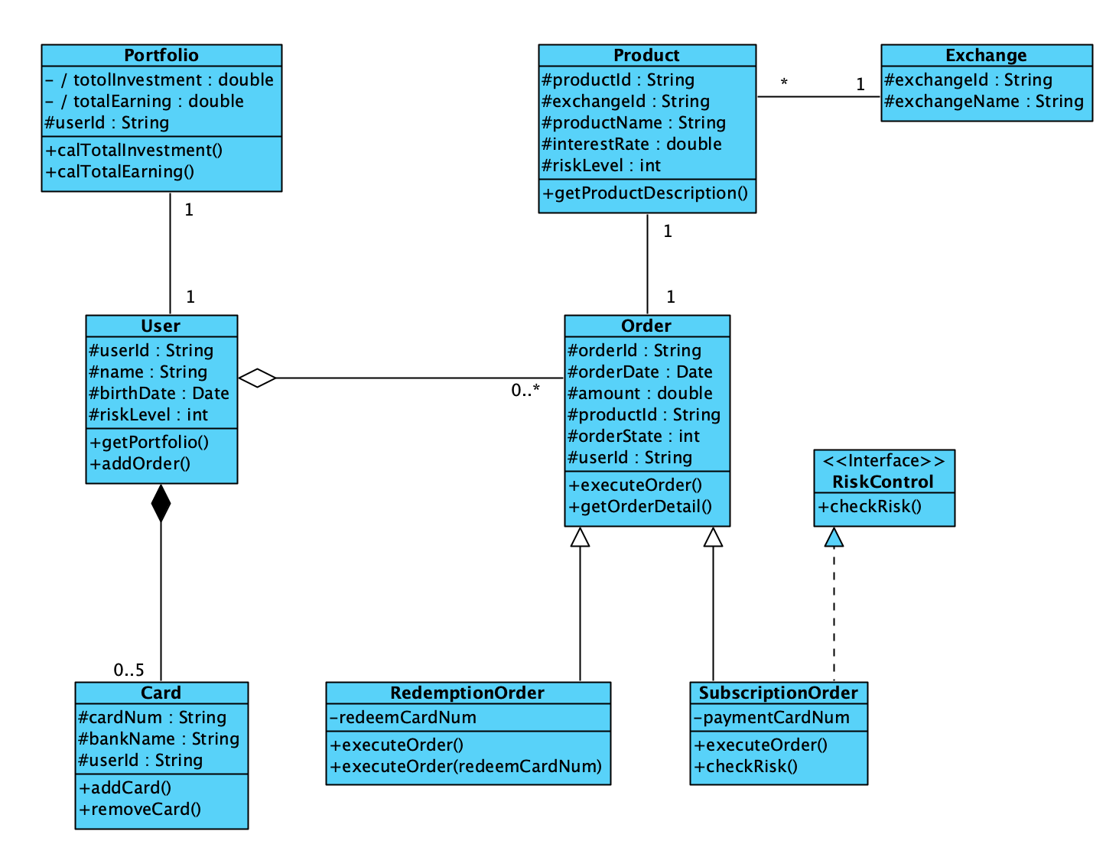
Class Diagram

Slide 4
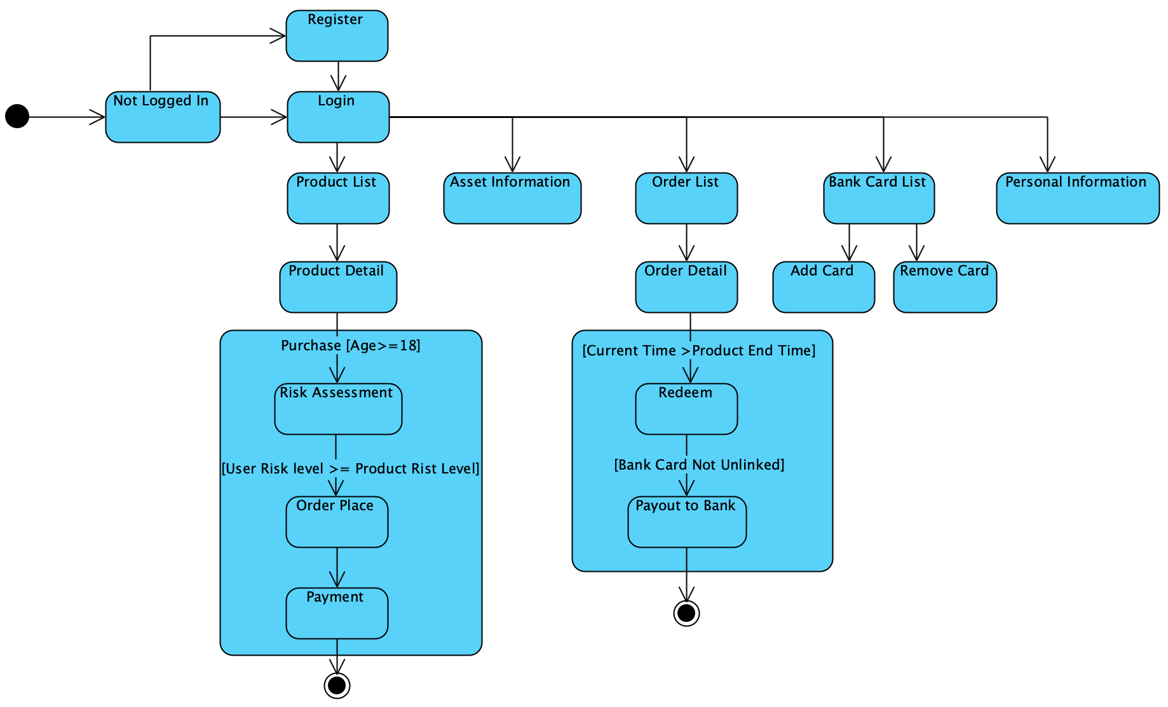
State Machine

Slide 5
OCL
1.User's Age Constraint
context User
inv : self.birthDate.diffInYears(currentDate) >= 18
2.Risk Level Compatibility
context Order
inv : self.userId.riskLevel >= self.productId.riskLevel
3.Bank Card Limit
context User
inv : self.cards->size() <= 5
4.Redeem Eligibility (Current Time Check)
context RedemptionOrder
inv : self.productId.endDate <= currentDate
5.Order Amount Positive Check
context Order
inv : self.amount > 0

Slide 6
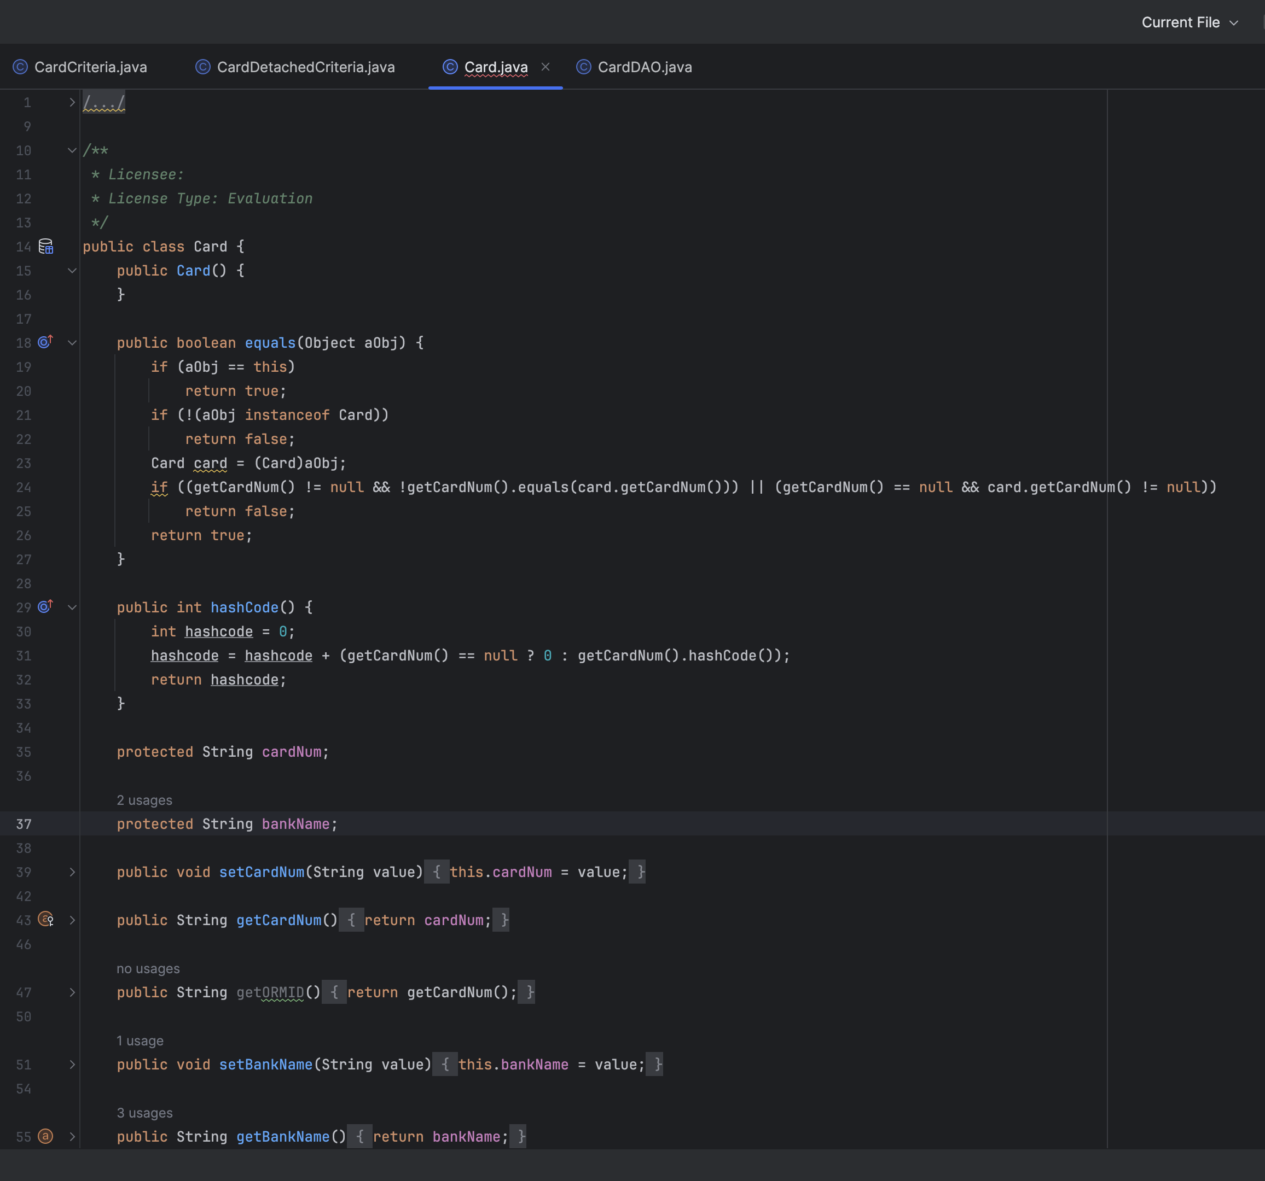
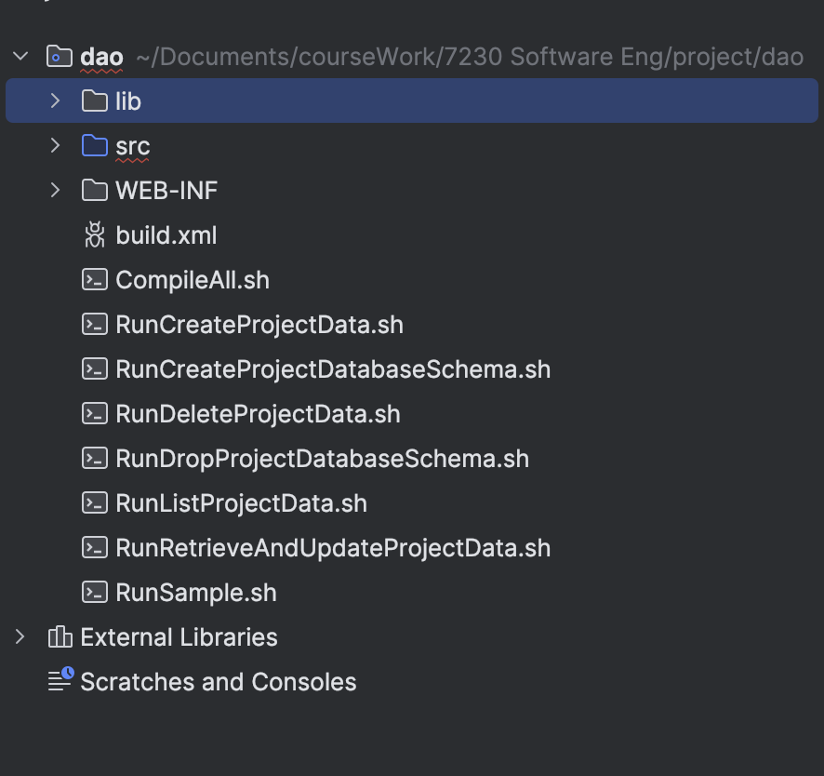
Generation: Code
Overall structure

Slide 7
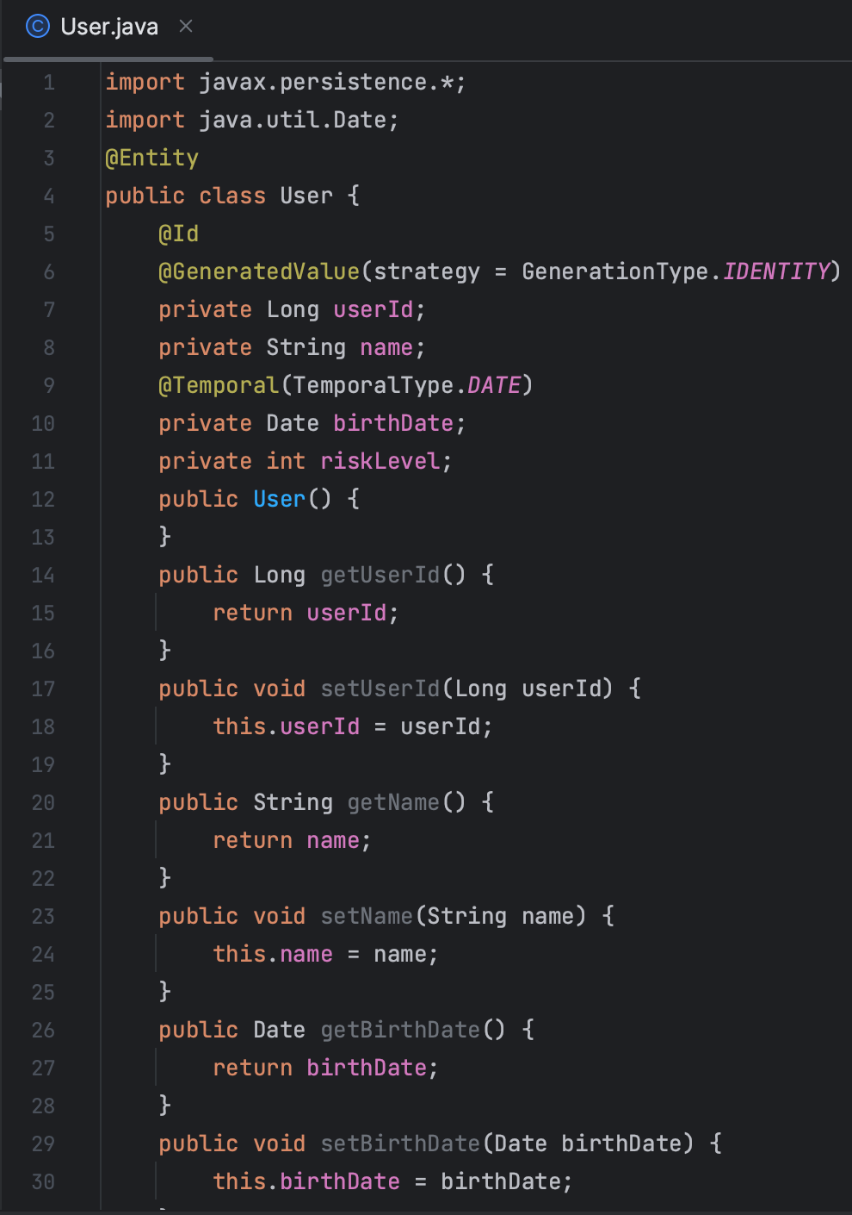
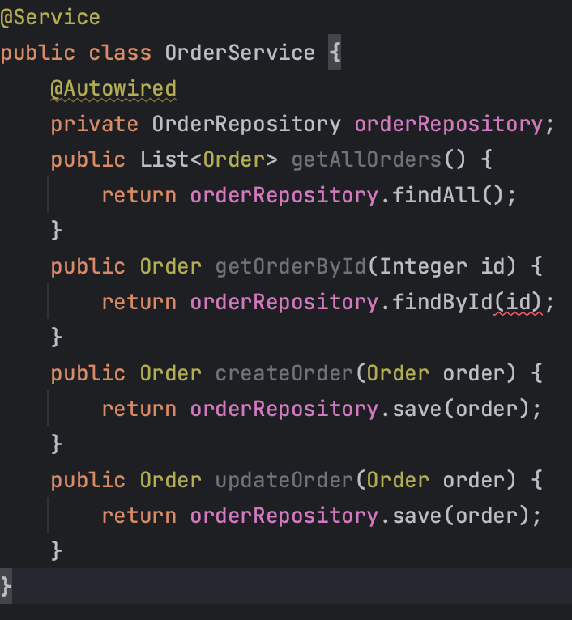
Generation: Code

Slide 8
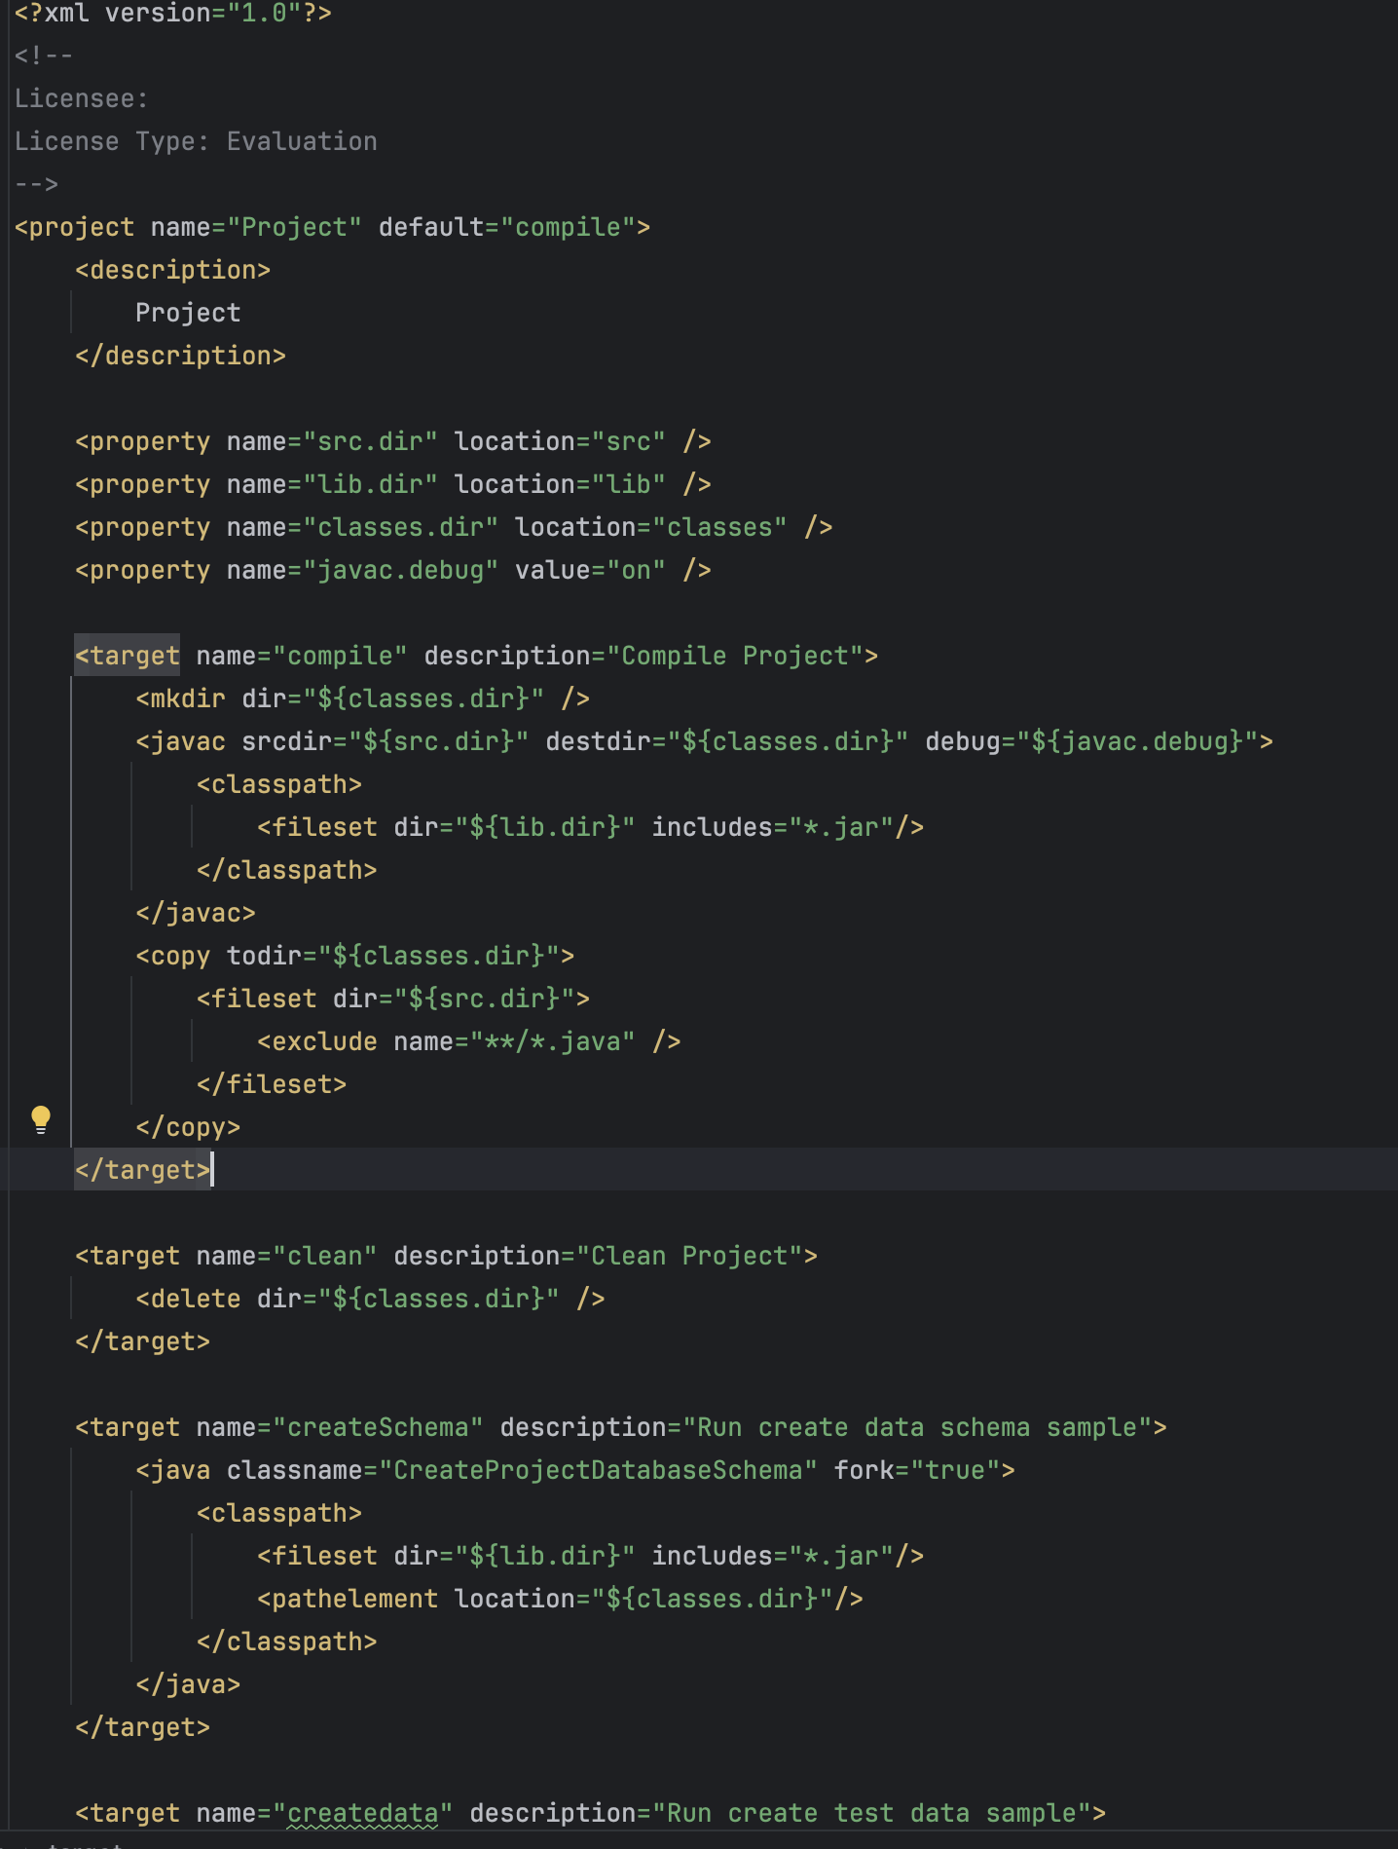
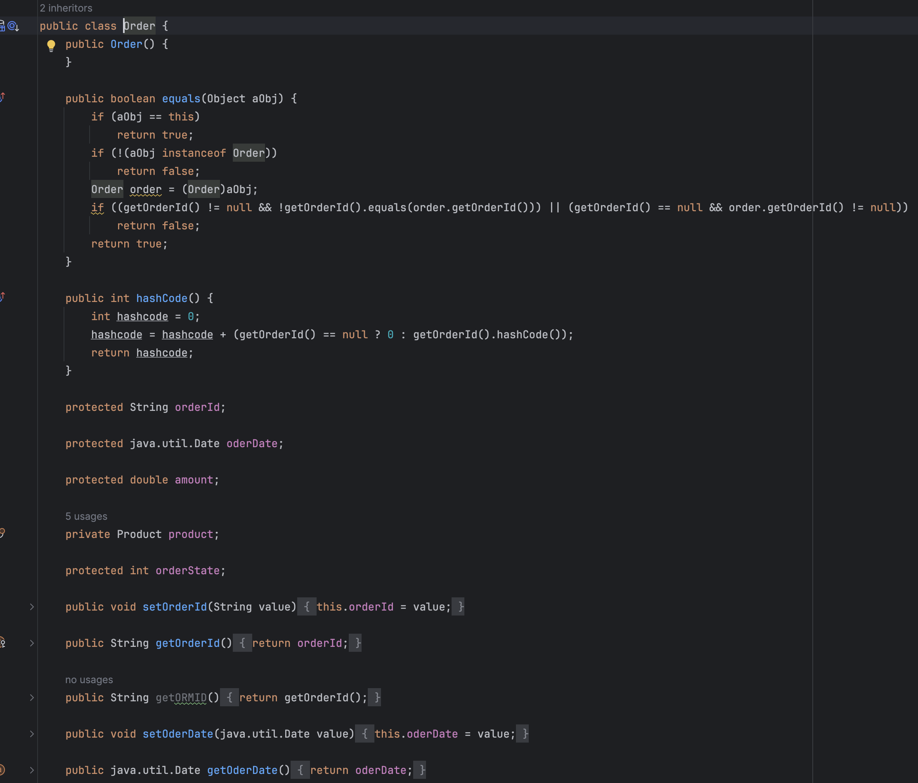
Generation: Code
Build file

Slide 9
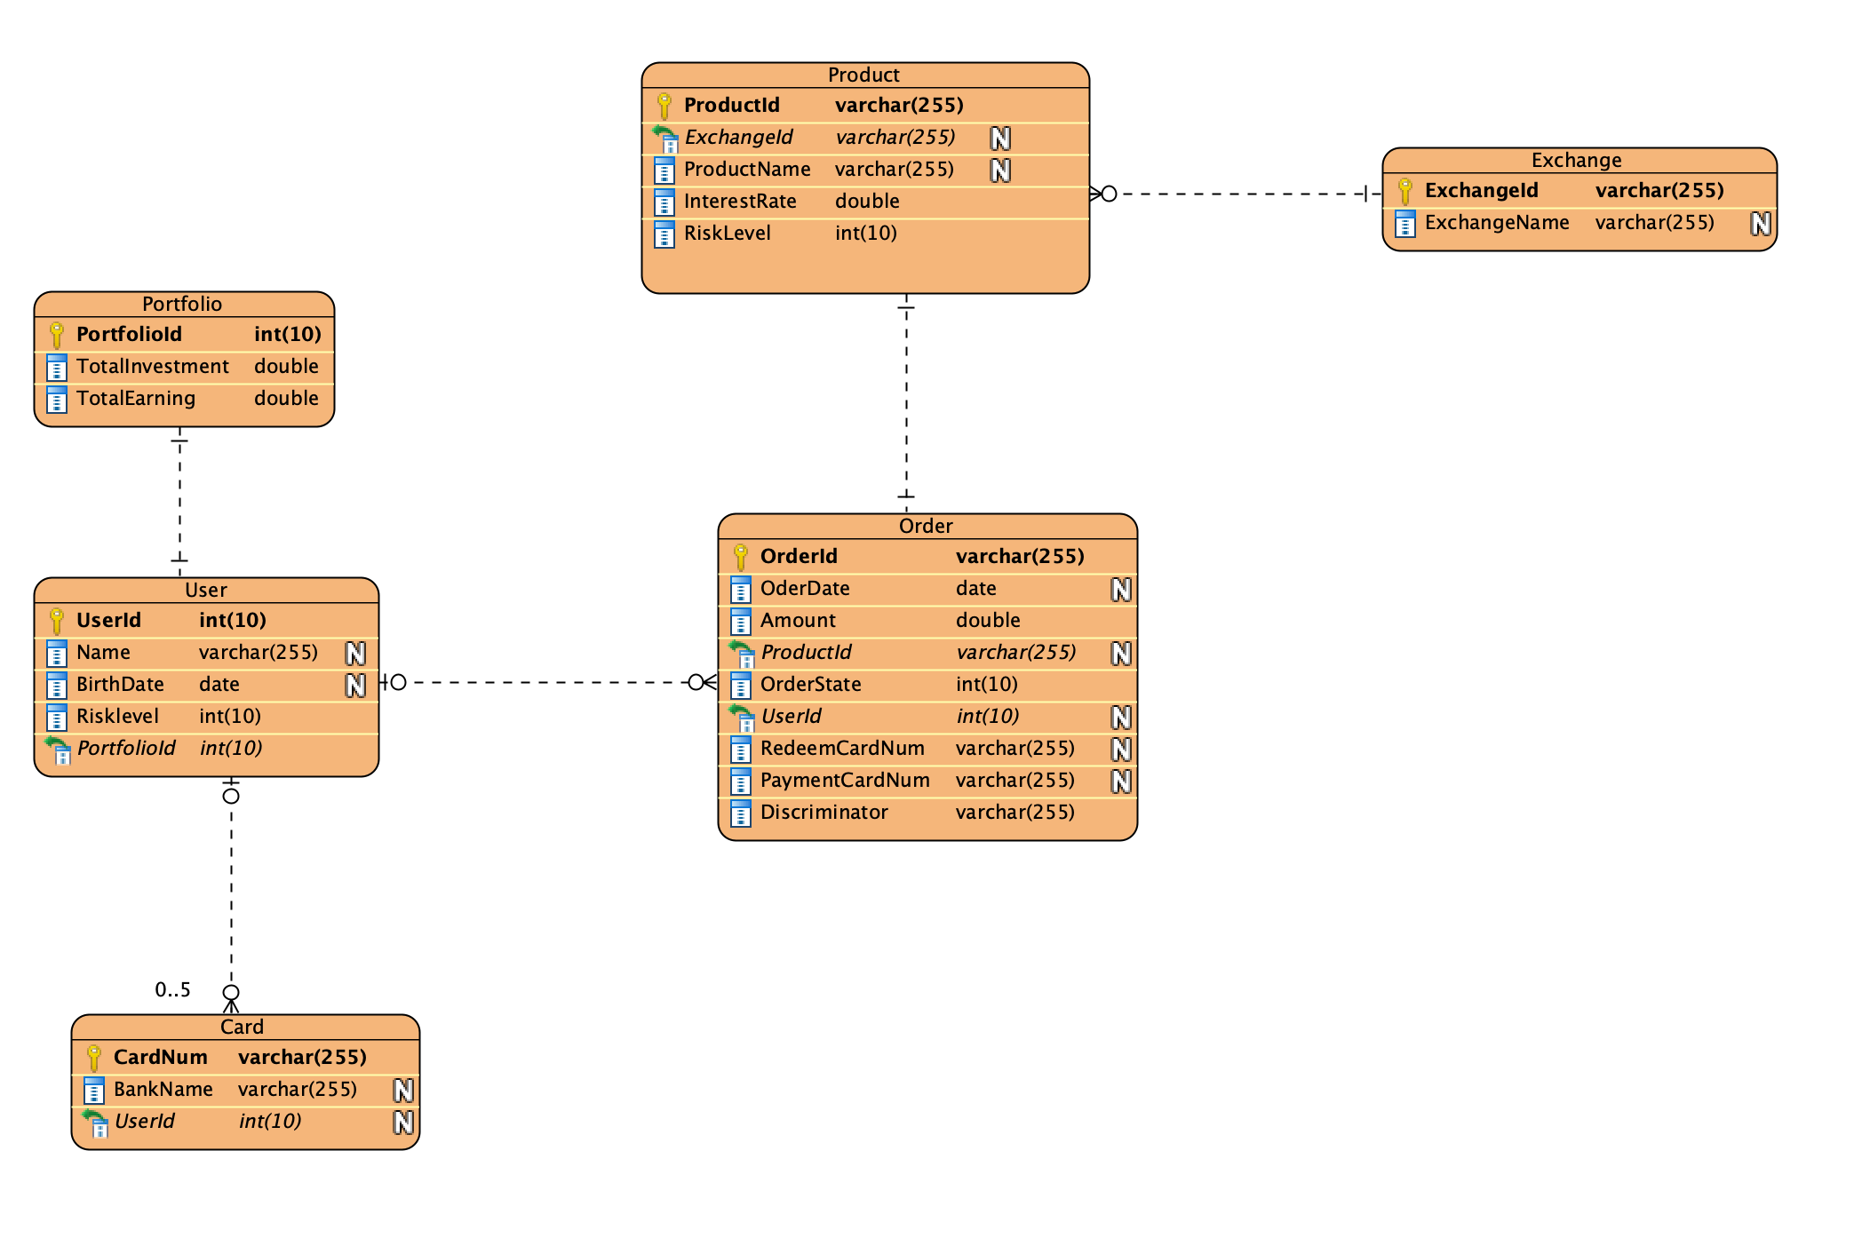
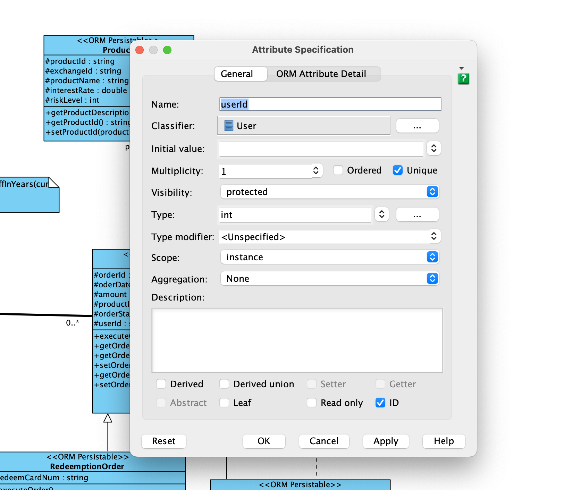
Generation: Database
Sepcify Primary keys
E-R Diagram

Slide 10
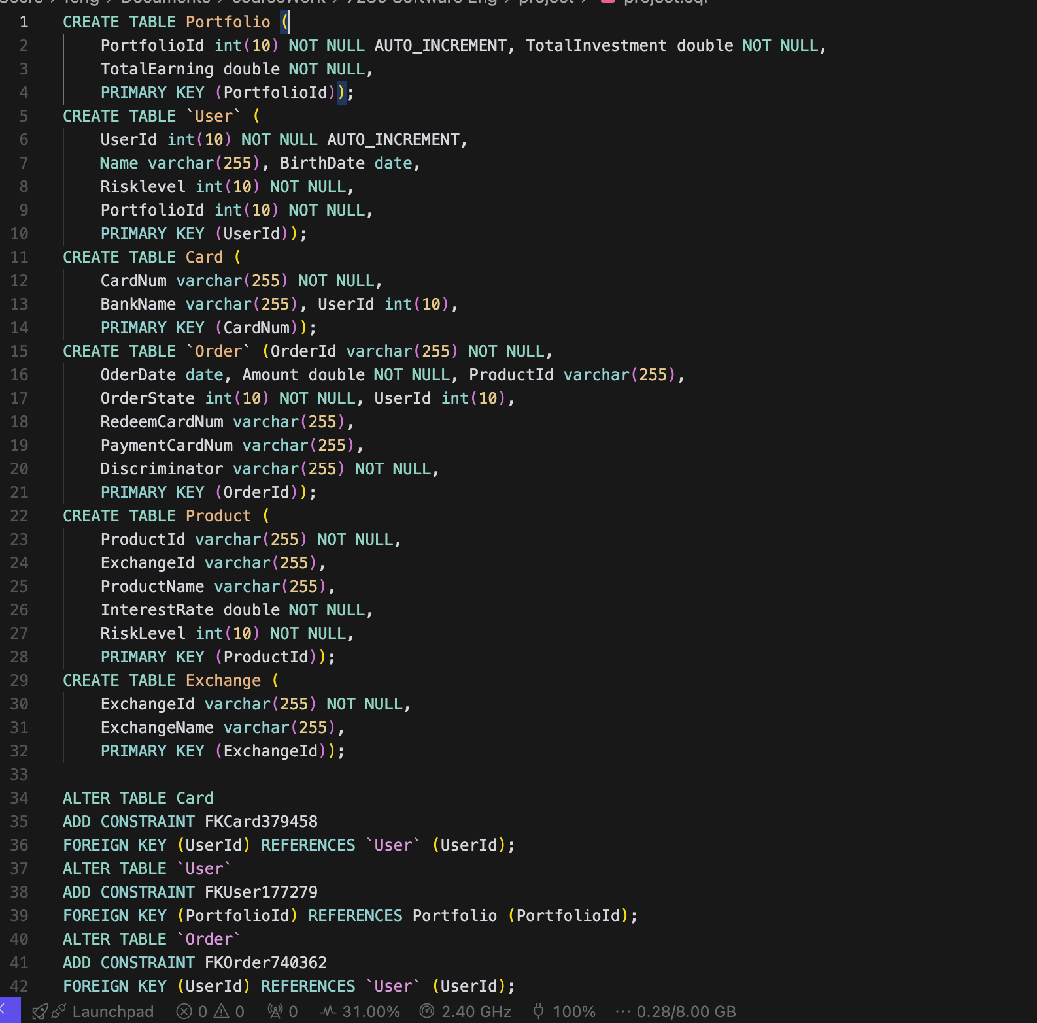
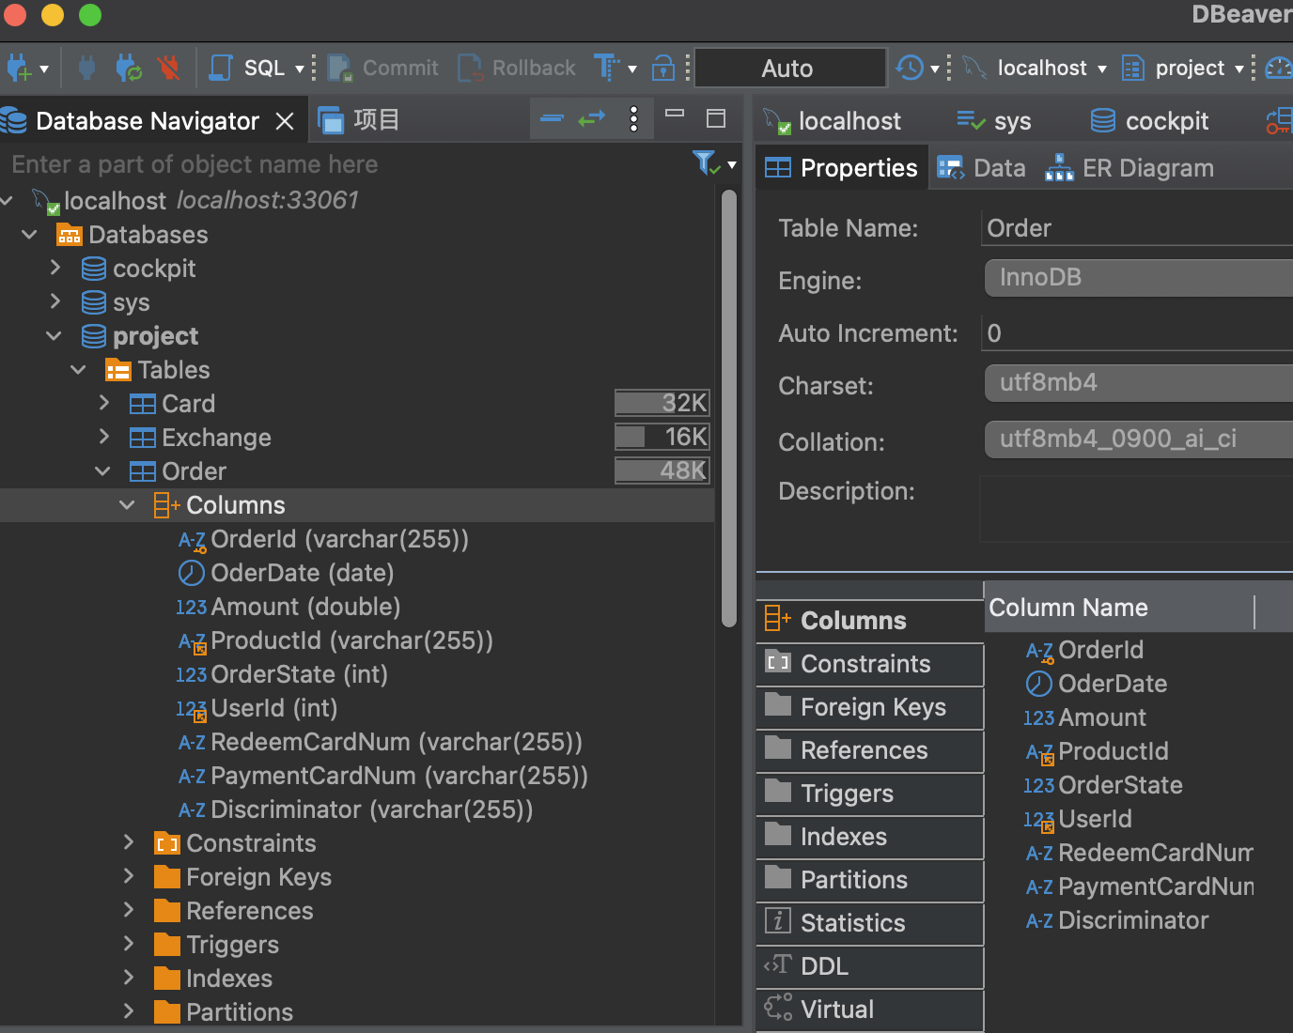
Generation: Database
Generated sql
Generated database outcome

Slide 11
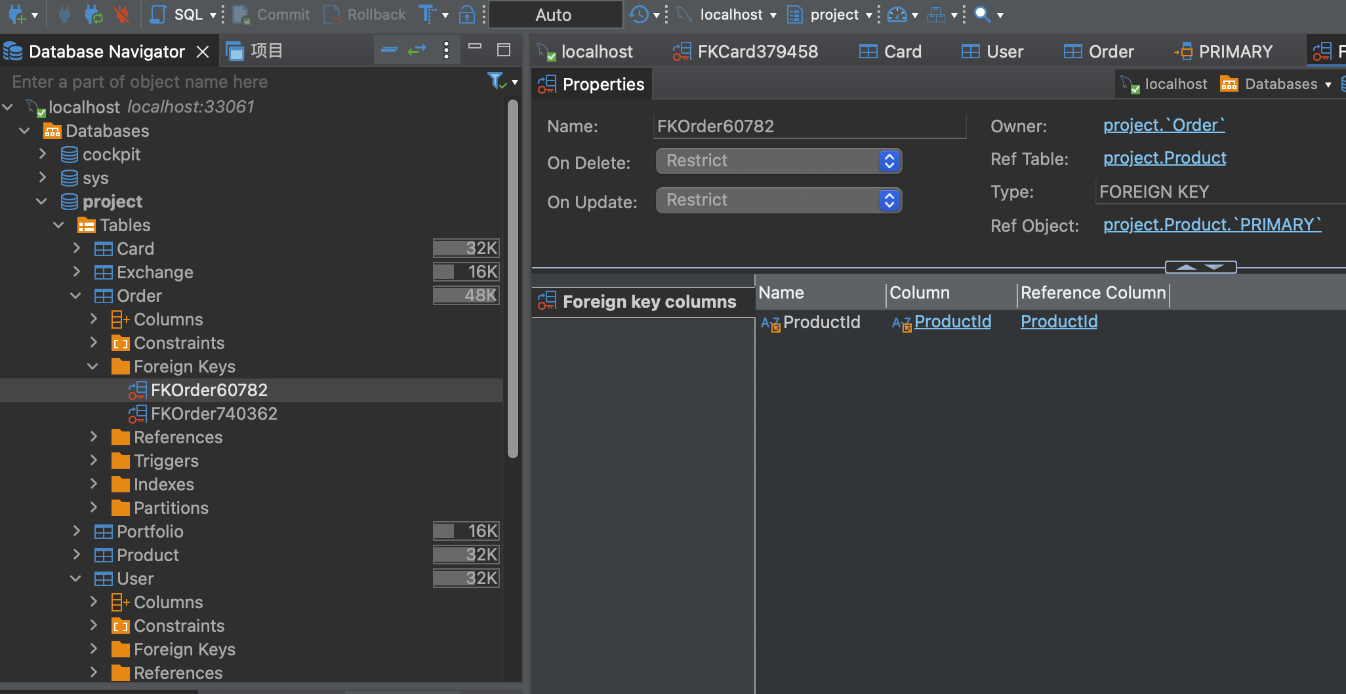
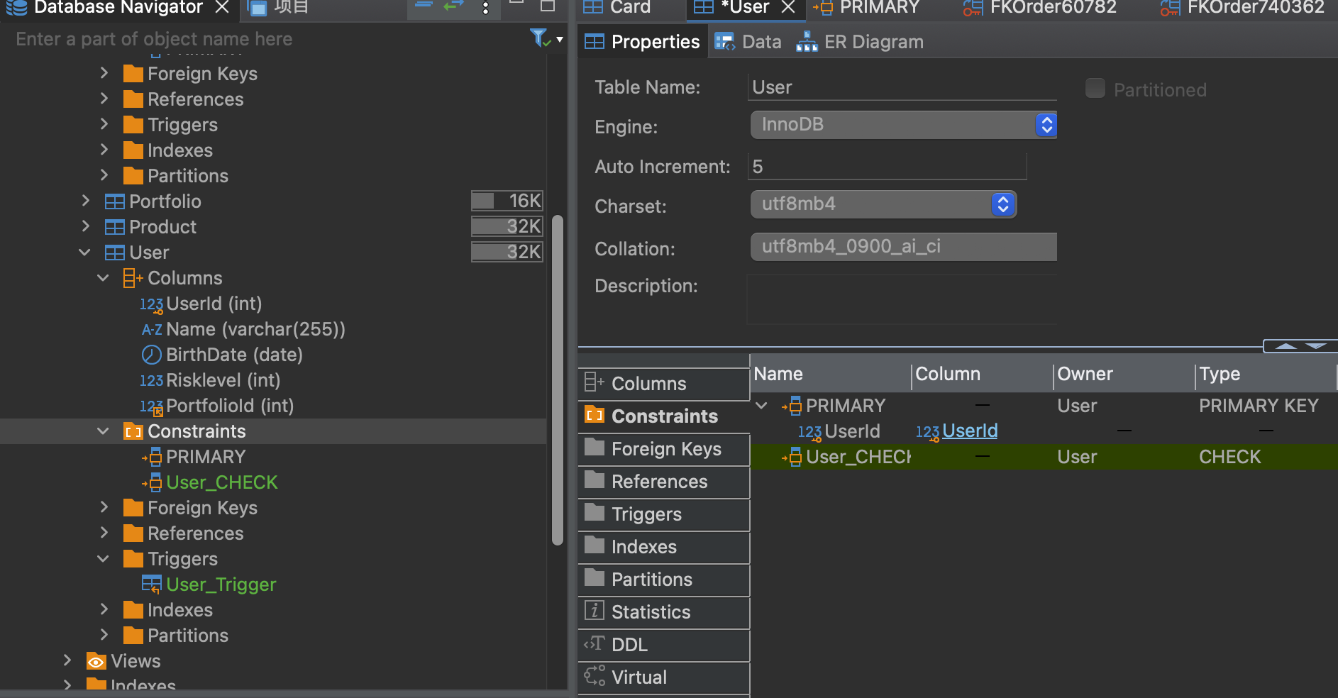
Generation: Database
Foreign key
Constraints and Triggers

Slide 12
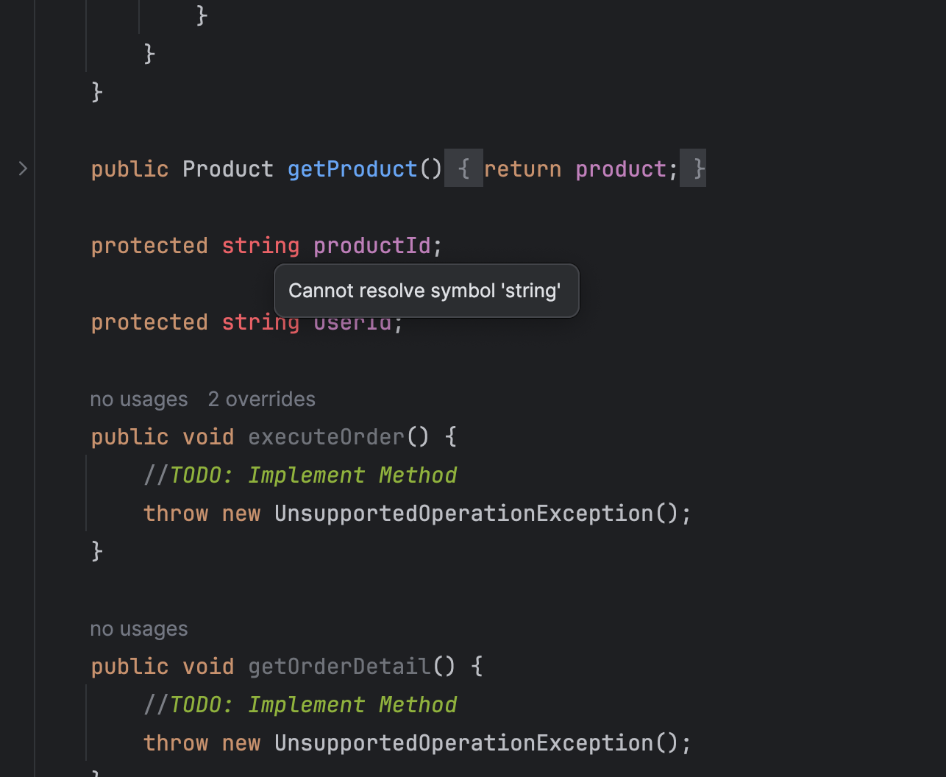
Generation: Flaws
Problem with string type: possibly casue by JDK version
Flaw with database: constraint only apply on attributes
Flaw with Erd: require manual input for primary keys

Slide 13
Technical Challenges
Challenge | Description
Database Design | Flexible schema for diverse financial products and transactions.
Entity Mapping | Accurate JPA mappings between users, orders, products, portfolios.
Real-time Updates | Efficient updates for portfolios, earnings, and transaction history.
Concurrency | Handling high-traffic transactions with scalability and reliability.
Database Query Optimization | As orders increase, query times may grow, slowing API responses. Implement optimizations to maintain performance
Floating-Point Precision | Ensure accurate calculations to avoid asset errors from precision loss.

Slide 14
Non-Technical Challenges
Challenge | Description
User Interface Design | Creating a user-friendly interface to enhance user interaction and engagement.
State Machine Design | Modeling user behaviors and system states with clear state machine diagrams.
Team Collaboration | Working closely with the team to ensure seamless integration and high quality.
Timeline Management | Managing project timelines and resources to ensure on-time delivery.
Business Understanding | Gaining financial domain knowledge to design a platform that meets user needs.
Privacy Protection | Using measures like asset display masking and encrypted storage of payment passwords

Slide 15
Tools
Visual Paradigm
CodeMR
SonarQube
Understand
Intellij IDEA

Slide 16
Project Timeline
Milestone | Deadline
Prototype Presentation | 6th Nov
Implementation Phase | 18th Nov
Final Presentation | 20th Nov
Submission of Report | 11th Dec

Slide 17
Thank you

